Slide 1

R.V.COLLEGE OF ENGINEERING, BENGALURU-560059 (Autonomous Institute Affiliated to Belagavi) Department of Electrical and Electronics Engineering
Speed Controller for 3 Phase BLDC Motor
Presented by:
Raghav Maheshwari (1RV14EE036)
Department of Electrical and Electronics Engineering
Under the guidance of
Dr. V. Chayapathy
Associate Professor

Slide 2
Objectives
To simulate and develop a speed controller hardware for a 3 phase BLDC motor
To design and manufacture a compact and PCB for the same
To write code for the same on an ATMEGA microcontroller
To minimize heat dissipation of Power MOSFETS
To build a load test rig and plot efficiency of the motor

Slide 3
Literature Survey
Author, Date | Title | Content
Mohamad Nasrul Abdul Satar, Dr. Dahaman Ishak; 2014 | Application of Proteus VSM in Modelling Brushless DC Motor Drives | This paper presents simulation and hardware implementation of 3-phase Permanent Magnet Brushless DC (PM BLDC) motor drive for low power applications. PWM control has been implemented for a 120-degree six-step trapezoidal BLDC motor. Processor used is PIC16F877 with functions: commutation sequence, rotating direction control, speed control and reading Hall sensor signals.
Md. Rifat Hazari, Effat Jahan, Md. Ettaker Siraj, Md. Tauhedull Islam Khan; 2015 | Design of a Brushless DC (BLDC) motor controller | Proposed design allows the user to rotate the motor in both directions. Depending on the rotor position the sensor will give response to the controller circuit. Controller circuit will fix the direction of current following to the stator. The design controller circuit is also implemented. The overall design consists of microcontroller circuit, logic gates, switching devices (MOSFET/BJT), BLDC motor, sensors.
Tako Nama, Anup Kumar Gogoi, Praveen Tripathy; Oct. 2017 | Application of a Smart Hall Effect Sensor System for 3-phase BLDC Drives. | The proposed work provides the intelligence to the hall sensor system to generate the necessary six firing sequence to run the motor, even when one of the hall sensor suddenly stops working in the middle of the run. This scheme is useful for emergency operation before replacing the damaged hall effect sensor.

Slide 4
BLDC Motor
Used electric scooters, cycles, aerospace industry, CNC machines, 3D printers, etc
Have higher efficiencies than DC and induction motors(high power applications).
Since brushes are not used- longer life and low maintenance
High precision motors
Expensive compared to other motors

Slide 5
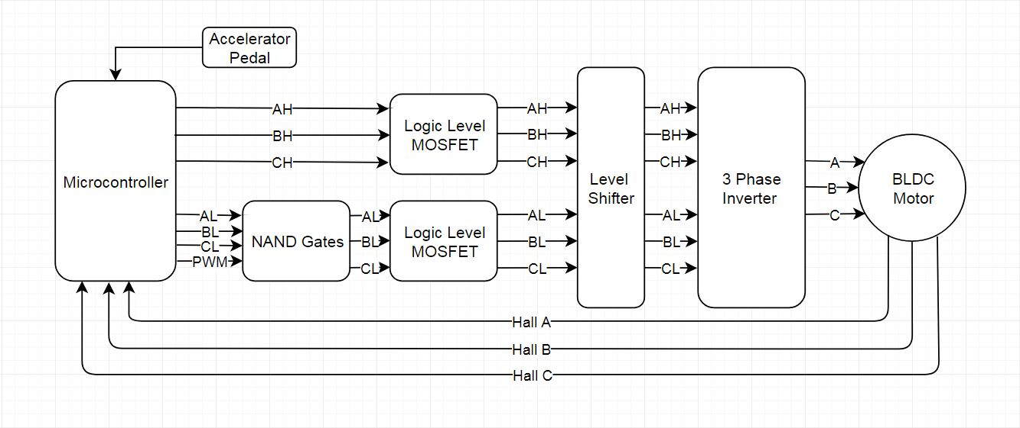
Block Diagram

Slide 6
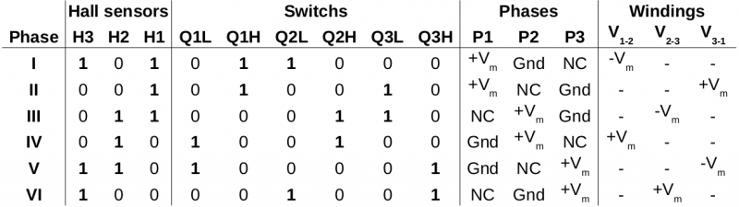
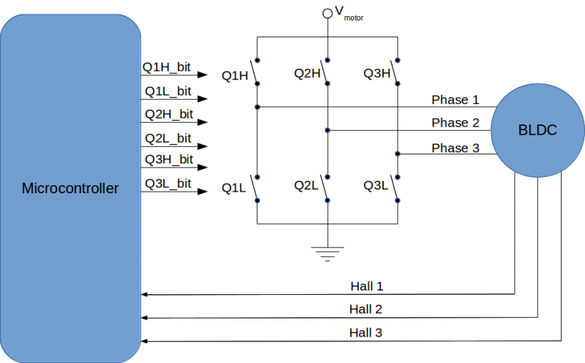
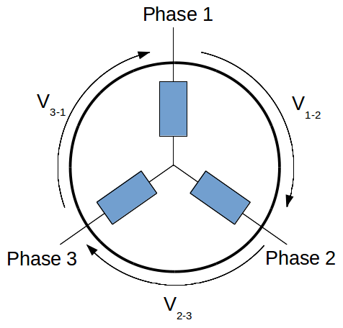
Commutation Sequence

Slide 7
Methodology
Perform necessary simulations
Test individual components on Perfboard
Based on test results, modify circuit
Design PCB, optimize
Test controller on motor
Build load test rig
Test controller on load and plot efficiency curves

Slide 8
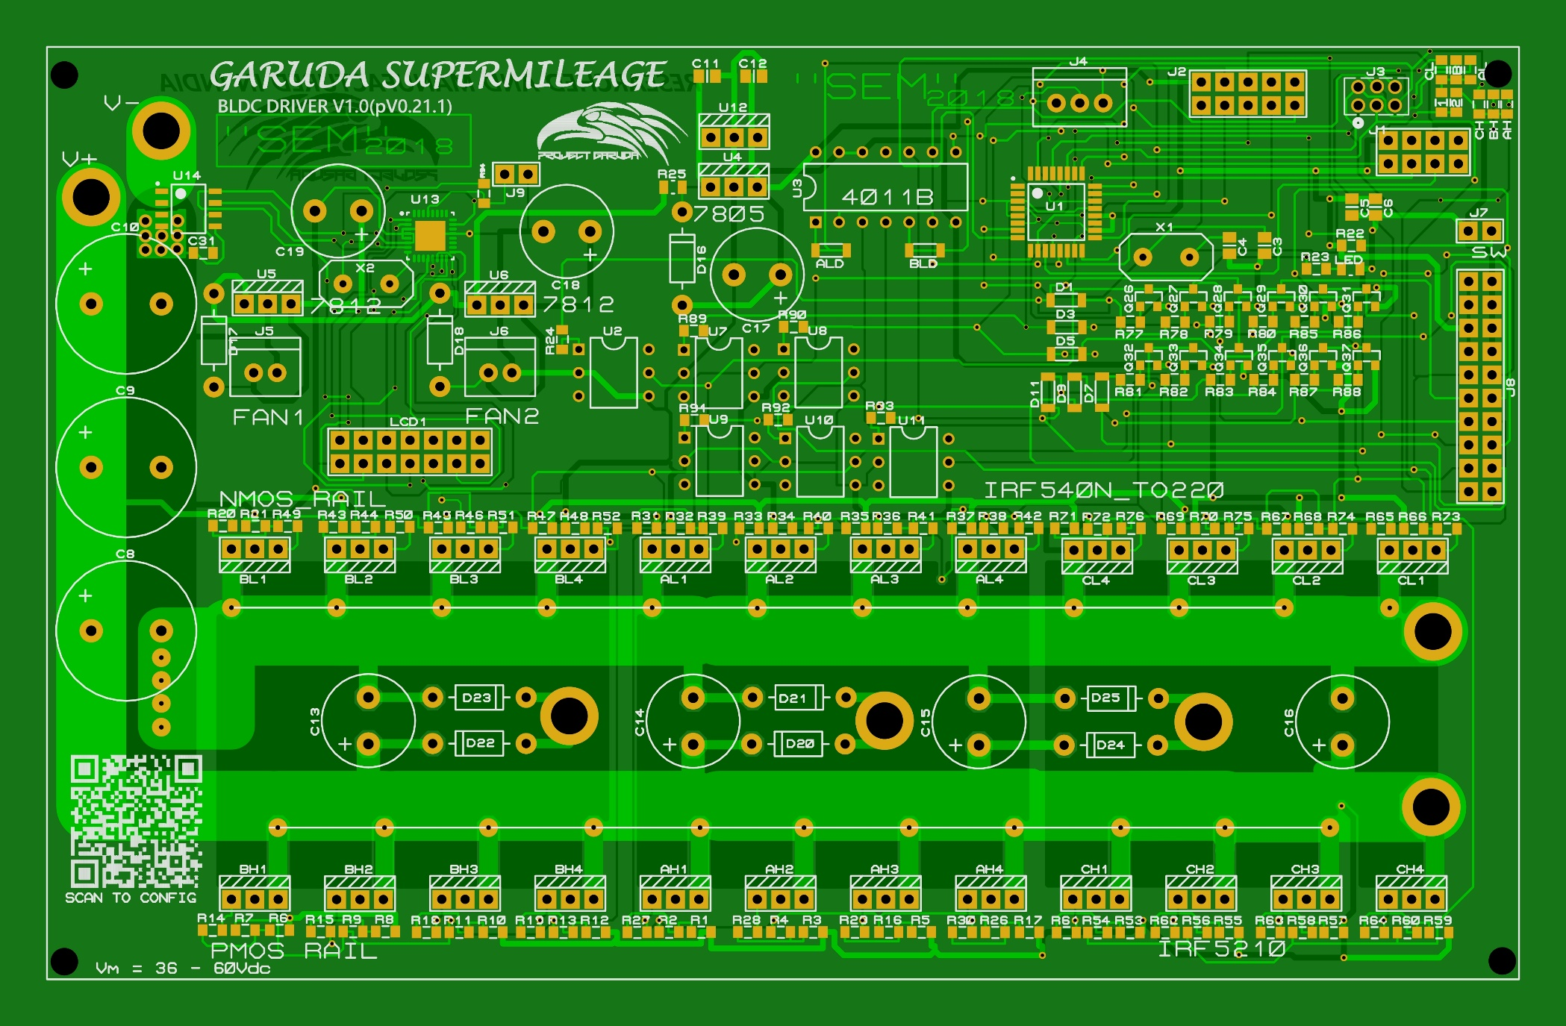
PCB

Slide 9
Cost
Component | Quantity(individual cost) | Cost
PCB | 6 | 4500
ATMEGA328P | 5(120) | 600
P-MOSFETs | 40(45) | 1800
N-MOSFETs | 40(15) | 600
Misc Components | - | ~500
Coupling for motors | 1 | ~1200
Stand for test rig | 1 | ~1500
Energy Meter | 1 | ~1500
Component | Cost
Motor 1 | 4000
Motor 2 | 4000
Battery(48V, 20Ah) | 35000
 | 43000
Available
Components

Slide 10
Timeline
10th April
Simulations and PCB Manufacturing
1st May
load test rig completion
20th May
Testing,
Compiling Report

Slide 11
Bibliography
B. Das, S. Chakraborty, P. M. Kasari, A. Chakraborti and M. Bhowmik, "Speed control of BLDC Motor using soft computing Technique and its stability analysis," vol. 3, issue 5, ISSN(Online):2249-071X.
Trapezoidal Control of BLDC Motors Using Hall Effect Sensors(2014); Texas Instruments application report
Hardware Design Considerations for an Electric Bicycle Using a BLDC Motor(2015); Texas Instruments application report
Power electronics in motor drives: Where is it? By Nagarajan Sridhar(August 2016)

